Slide 1



Loan Approval Prediction
Md Sarique
PGA-43

Slide 2

Introduction
Overview:
This project focuses on building a machine learning model to predict whether a loan will be approved based on various applicant data. The model aims to assist financial institutions in automating the loan approval process and reducing risk by identifying key factors that influence loan approval.
The model chosen for this task is Logistic Regression, which is effective for binary classification tasks like loan approval.

Slide 3
Problem Statement
Problem Statement Explained:
The primary objective of this project is to predict the outcome of a loan application (either Approved or Not Approved) based on various applicant and loan-related features.
This problem is critical for financial institutions to optimize their decision-making process, minimize risk, and improve customer satisfaction.

Slide 4
Data Description
Dataset Description : The dataset contains applicant and loan-related data, including demographic, financial, and loan-specific features.
Number of Records : The dataset includes [insert number] records.
Number of Features : features, including both categorical and numerical data.
Target Variable: The target variable is Loan Status, which indicates whether a loan is Approved or Not Approved.
key Feature : Applicant Income , Coapplicant Income , LoanAmount , Credit History

Slide 5
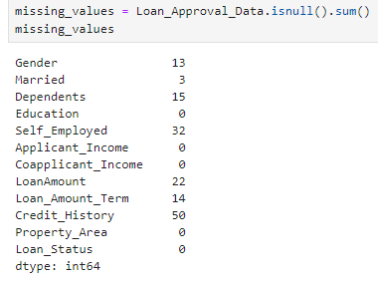
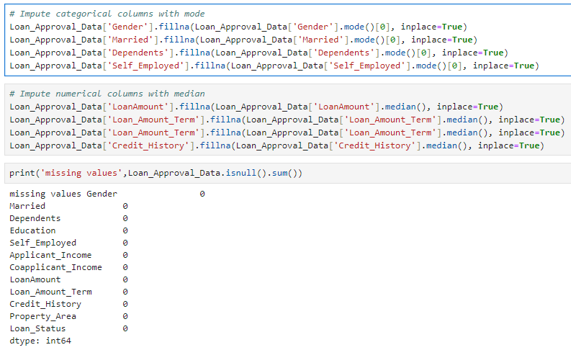
Pre Processing
Handling Missing Value :
Missing values in categorical features (e.g., Gender, Married, Self Employed) were filled using the mode.
Missing values in numerical features (e.g., LoanAmount, Loan Amount Term) were imputed using the median.

Slide 6
Exploratory Data Analysis
Numerical Features :
Applicant Income and LoanAmount are right-skewed with some extreme outliers, indicating a need for outlier treatment.
Categorical Features
Credit History, Married, and Education showed imbalanced distributions, with Credit History = 1 being the most common.
Credit History and Loan Approval :
Applicants with a good credit history (Credit History = 1) were significantly more likely to have their loans approved.
Coapplicant Income :
Coapplicant Income had a relatively small impact on loan approval, showing weaker correlation with Loan Status.
Property Area Impact :
Property Area showed some variation, with applicants from semi-urban areas having a slightly higher approval rate.
Multicollinearity :
No strong multicollinearity was found between features, ensuring that the predictors were largely independent of each other.

Slide 7
Feature Engineering
Encoding Categorical Variables :
Missing values in categorical features (e.g., Gender, Married, Self Employed) were filled using the mode.
Missing values in numerical features (e.g., LoanAmount, Loan Amount Term) were imputed using the median.
Outlier Treatment :
Outliers in numerical columns such as Applicant Income and LoanAmount were handled using the IQR (Interquartile Range) method, capping extreme values.
Feature Encoding (Dummy Creation)
Categorical variables were encoded using pd.get dummies(), which automatically created dummy variables for all categorical columns and handled them efficiently.
Scaling : Numerical variables were standardized using Z-score normalization to bring them onto a similar scale

Slide 8
Model Selection
Why Logistic Regression for this problem statement ?
Logistic regression is a well-suited algorithm for binary classification problems like loan approval. It is interpretable and performs well with categorical and numerical data.
Less Computationally Intensive: Logistic Regression is efficient and less computationally intensive compared to more complex models like decision trees or neural networks. This makes it ideal for relatively small to moderately sized datasets like ours.
Model Output
Probability Scores: Logistic Regression provides probability scores between 0 and 1 for each instance, helping us classify loan approvals based on a decision threshold (typically 0.5).
Coefficients: The model assigns coefficients to each feature, indicating the importance and direction (positive or negative) of each feature in determining loan approval.

Slide 9
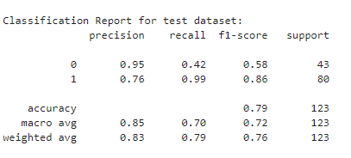
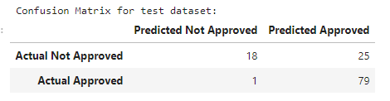

Model Evaluation
The logistic regression model was evaluated using several metrics:
Confusion Matrix : This matrix shows the number of true positives, false positives, true negatives, and false negatives.
Classification Report : Metrics such as precision, recall, and F1-score were calculated for both loan approval and rejection.
AUC Score : The model’s AUC score was 0.7183139534883721, indicating the overall performance of the model.

Slide 10
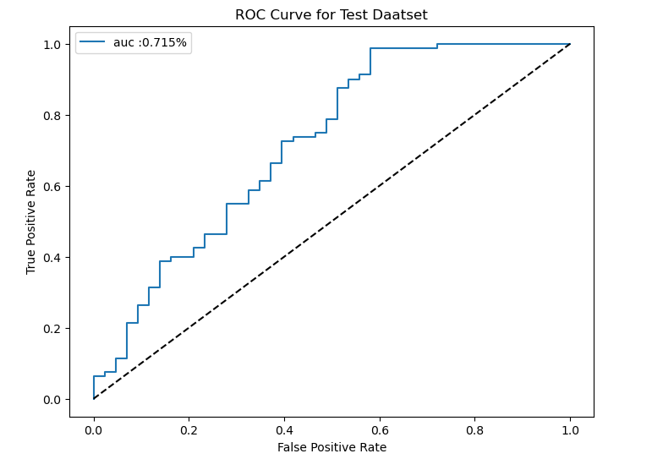
ROC Curve
The ROC curve (Receiver Operating Characteristic) is used to visualize the trade-off between the True Positive Rate (TPR) and the False Positive Rate (FPR) at different classification thresholds.
The model achieved an AUC score of 0.8239628713842773indicating a good ability to distinguish between loan approvals and rejections.

Slide 11
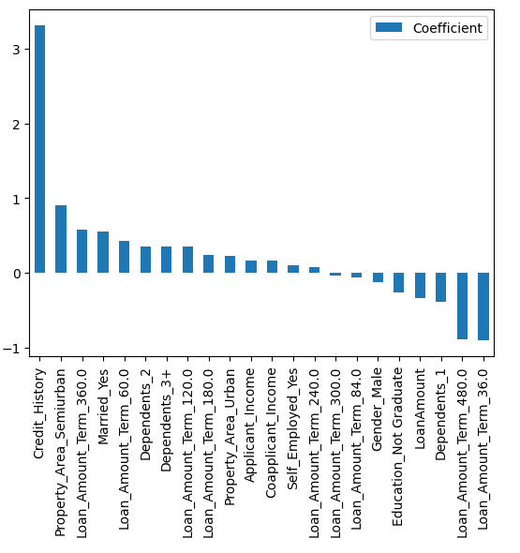
Feature Importance
The coefficients from the logistic regression model indicate the importance of different features in predicting loan approval
Positive Impact : Features like Credit History had a significant positive influence on loan approval.
Negative Impact : Features like LoanAmount had a negative influence, indicating higher loan amounts reduced the likelihood of approval.

Slide 12
Conclusion
The logistic regression model performed well, with an accuracy of [insert accuracy] and an AUC score of [insert AUC].
Positive Impact : Features like Credit History had a significant positive influence on loan approval.
Negative Impact : Features like LoanAmount had a negative influence, indicating higher loan amounts reduced the likelihood of approval.
Key Findings :
Applicant Income Higher applicant incomes had a positive impact on loan approval, though the influence was not as strong as credit history.
Dependents : Applicants with dependents showed a slight reduction in loan approval probability, suggesting that having dependents may introduce additional financial strain that lenders consider during the approval process.

Slide 13
Thank You

